Slide 1
For Hospital Art:
Delete Slide
Google this:
clean graphical line art hospital for powerpoint

Slide 2

Hospital Stay Duration Analysis
Tracy Dower & Blake Armstrong
MSDS 6732 – Applied Statistics

Slide 3
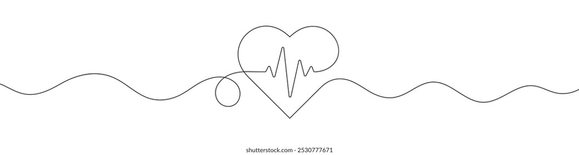
Introduction
Objective(s) overview, project outline, and data description/variables used

Slide 4
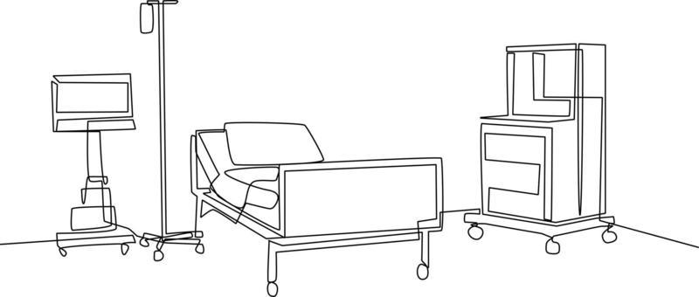
EDA
Summary of data cleaning
How was the data split if it was? What percentage?
Summary statistics / Visual assessments / Others
Additional visual assessments for interactions/model complexity/addressing assumptions

Slide 5
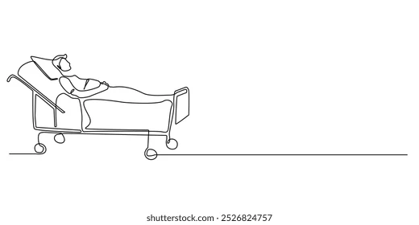

Slide 6
Objective 1 – Infection Rate
MLR model (Objective 1)
Describe the general approach to building your modeling to answer the primary question. This can be based on the question, linking key insight from EDA and/or incorporating information from feature selection or AIC model comparisons, etc
Produce an equation for the model (If its too long just make sure it is clearly stated what predictors are being used)
Groups should consider carefully what tests and/or confidence intervals could be used to help answer the objectives question(s). In addition to addressing the objective, there should be at least one formal interpretation of a regression coefficient along with a confidence interval. For some objectives, additional interpretations or summaries may be needed. It is up to the group to decide on what is appropriate. The groups may use any MLR related tests from last semester as well as partial F-tests.

Slide 7
Objective 2 – Complex Modeling and Comparison
Nonadditive/Complex MLR model for Objective 2
Remind us what EDA graphics support your idea of including any potential interactions. If you think its weak support of including an interaction, just communicate that. Hopefully we will see some evidence of needing interactions, but if you cannot find any, show us a few graphs of what seems like it may be helpful to consider, even if it is a stretch visually.
Make sure the model is clearly stated. What predictors are included additively? What interactions and what polynomial terms have been added? If feature selection suggests that you do not include any interaction terms, state this and include them anyways as an experiment.
Model Comparisons for Objective 2
Compare objective 1 model, the complex MLR model from #4, and at least one addition nonparametric mode using an appropriate error metric. Interpret MSE if applicable
Conclusions: General Findings / Scope of inference / What would you do if given more time / Would you use this moving forward / etc

Slide 8
Contacts
Pictures and emails to reference at the end.

